Slide 1
Operators
An operator is a symbol that tells the compiler to perform specific mathematical or logical operation.
C++ has six categories of operators:
Arithmetic Operators
Relational Operators
Logical Operators
Bitwise Operators
Misc Operators
Assignment Operators

Slide 2
Arithmetic Operators
Operator | Description | Example
+ | Adds two operands | 5 + 7 will give 12
- | Subtracts second operand from the first | 4 - 2 will give 2 2 – 4 will give -2
* | Multiplies both operands | 2 * 7 will give 14
/ | Divides numerator by de-numerator | 4 / 2 will give 2
% | Modulus Operator and remainder of after an integer division | 7 % 5 will give 2 4 % 2 will give 0

Slide 3
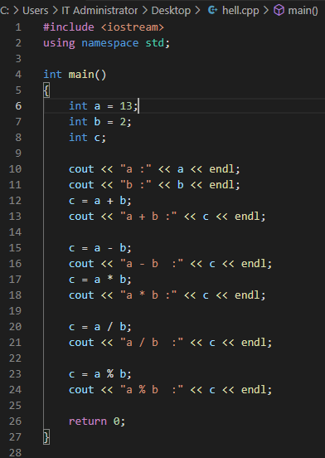
Arithmetic Operators
Let’s consider the following example:

Slide 4
Arithmetic Operators
However, some of these operators can be combined to produce a different operation, eg ++ and ---
Operator | Description | Example
++ | Increment operator: increases integer value by one | a++ will give 6
-- | Decrement operator: decreases integer value by one | a-- will give 4

Slide 5
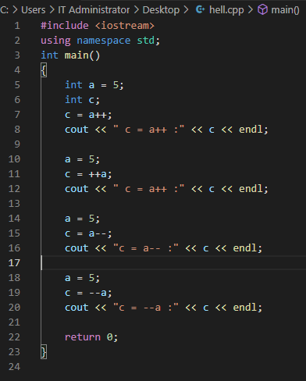
Arithmetic Operators
Let’s consider the following example:

Slide 6
Relational Operators
Operator | Description
== | Checks if the values of two operands are equal or not, if yes then the condition becomes true.
!= | Checks if the values of two operands are equal or not, if values are not equal then the condition becomes true.
> | Checks if the value of the left operand is greater than the value of the the right operand, if yes then the condition becomes true.
< | Checks if the value of the left operand is less than the value of the right operand, if yes then the condition becomes true.
>= | Checks if the value of the left operand is greater than or equal to the value of the right operand, if yes then the condition becomes true.
<= | Checks if the value of the left operand is less than or equal to the value of the right operand, if yes then the condition becomes true.

Slide 7
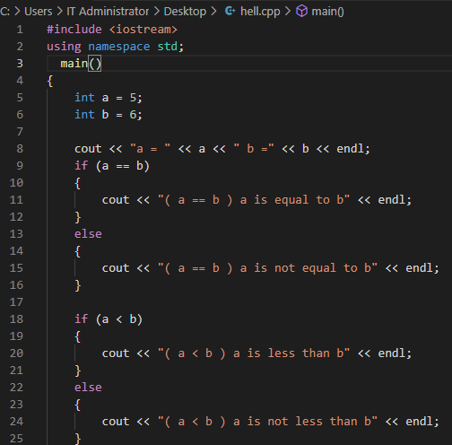

Relational Operators
Let’s consider the following example:

Slide 8
Logical Operators
C++ supports the three logical operators
*
Not (!),
And (&&)
*
OR (||)
*

Slide 9
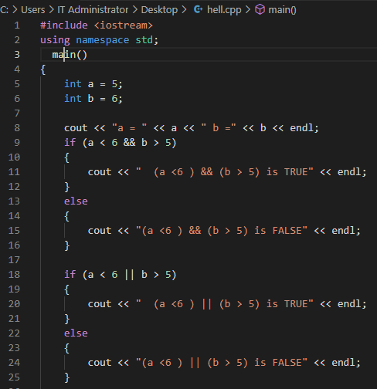
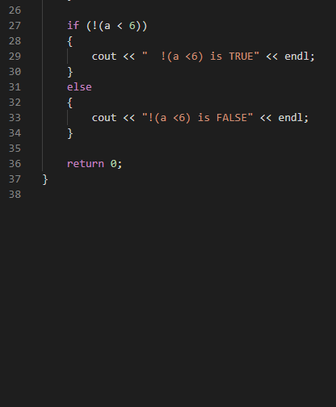
Logical Operators
Let’s consider the following example:

Slide 10
Bitwise Operators
Operator | Description
& | Binary AND Operator copies a bit to the result if it exists in both operands.
| | Binary OR Operator copies a bit if it exists in either operand.
^ | Binary XOR Operator returns 1 if the bits of both operands at the same position are different and returns 0 if they are the same
~ | Binary Ones Complement Operator is unary and has the effect of 'flipping' bits.
<< | Binary Left Shift Operator. The left operands value is moved left by the number of bits specified by the right operand.
>> | Binary Right Shift Operator. The left operands value is moved right by the number of bits specified by the right operand.

Slide 11
Bitwise Operators
Now let’s assume a=20 and b= 14 and they are both stored in an 8 bit register
a=0001 0100 b=0000 1110
To perform the bitwise operation you compare the bit position of the operands
Operation | Outcome | Decimal Value
(A & B) | 0001 0100 0000 1110 0000 0100 | 4
(A | B) | 0001 0100 0000 1110 0001 1110 | 30
(A ^ B) | 0001 0100 0000 1110 0001 1010 | 26
(~A ) | 0001 0100 1110 1011 | -21
A << 2 | 0001 0100 0101 0000 | 80
A >> 2 | 0001 0100 0000 0011 | 3

Slide 12
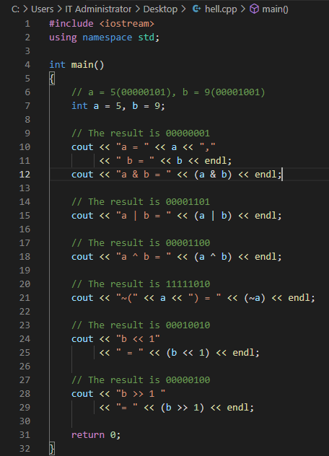
Bitwise Operators
Let’s consider the following example:

Slide 13
Assignment Operator
The assignment operator can be combined with other operators. The table below shows the various combinations.
Operator | Description | Example
+= | Add AND assignment operator, It adds right operand to the left operand and assign the result to left operand. | C += A is equivalent to C = C + A
-= | Subtract AND assignment operator, It subtracts right operand from the left operand and assign the result to left operand. | C -= A is equivalent to C = C – A
*= | Multiply AND assignment operator, It multiplies right operand with the left operand and assign the result to left operand. | C *= A is equivalent to C = C * A

Slide 14
Assignment Operator
Operator | Description | Example
/= | Divide AND assignment operator, It divides left operand with the right operand and assign the result to left operand. | C /= A is equivalent to C = C / A
%= | Modulus AND assignment operator, It takes modulus using two operands and assign the result to left operand. | C %= A is equivalent to C = C % A
<<= | Left shift AND assignment operator. | C <<= 2 is same as C = C << 2
>>= | Right shift AND assignment operator. | C >>= 2 is same as C = C >> 2
&= | Bitwise AND assignment operator. | C &= 2 is same as C = C & 2

Slide 15
Assignment Operator
Operator | Description | Example
^= | Bitwise exclusive OR and assignment operator. | C ^= 2 is same as C = C ^ 2
|= | Bitwise inclusive OR and assignment operator. | C |= 2 is same as C = C | 2

Slide 16
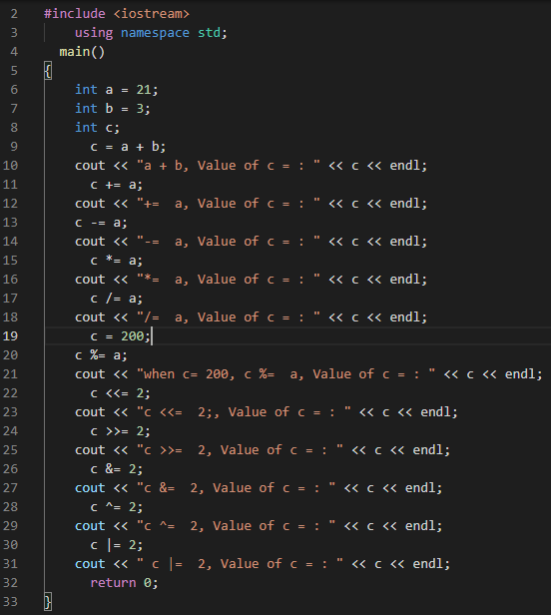
Assignment Operator
Let’s consider the following example

Slide 17
Misc Operators
C++ supports other operators and the table below shows other operators that C++ supports.
Operator | Description
Cast | Casting operators convert one data type to another.
, | Comma operator causes a sequence of operations to be performed. The value of the entire comma expression is the value of the last expression of the comma-separated list.
Condition ? X : Y | Conditional operator (?). If Condition is true then it returns value of X otherwise returns value of Y.
& | Pointer operator & returns the address of a variable.
* | Pointer operator * is pointer to a variable.
Sizeof | sizeof operator returns the size of a variable. For example, sizeof(a), where ‘a’ is integer, and will return 4.

Slide 18
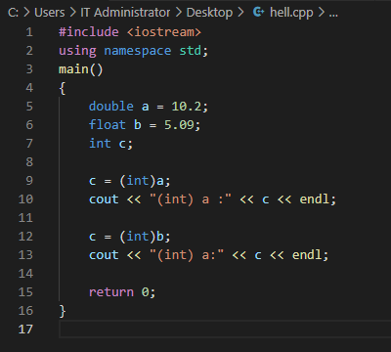
Misc Operators Cast
A cast is a special operator that forces one data type to be converted into another data type.

Slide 19
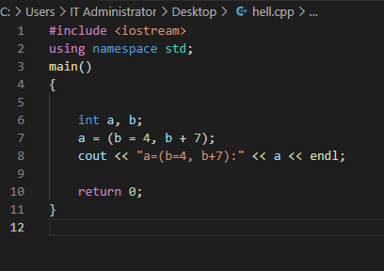
Misc Operators , (Comma)
The comma operator (,) is used to separate two or more expressions that are included where only one expression is expected.

Slide 20
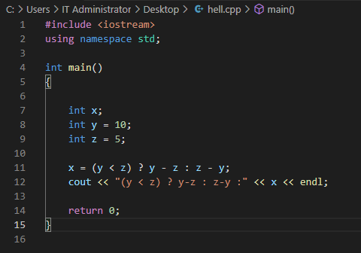
Misc Operators Conditional ? : Operator
The conditional operator evaluates an expression returning a value if that expression is true and a different one if the expression is evaluated as false.
Its format is:
condition? Exp1 : Exp2;

Slide 21
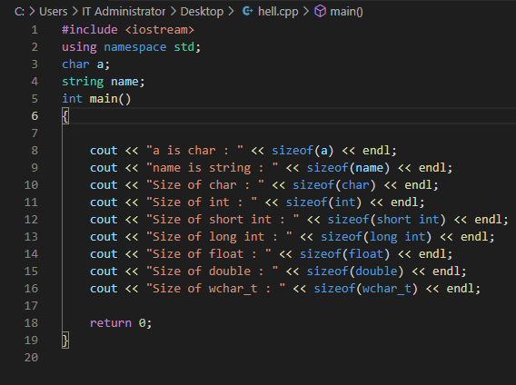
Misc Operators Sizeof Operator
It is a compile-time operator that determines the size, in bytes, of a variable or data type

Slide 22
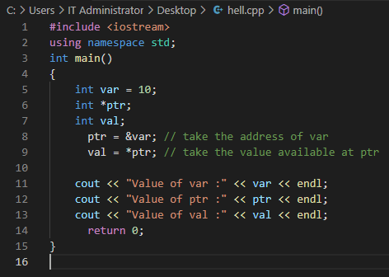
Misc Operators & and * (Pointer Operator)
Reference Operator (&): The & is a unary operator that returns the memory address of its operand.
Dereference Operator (*) : The dereference operator * returns the value of the variable located at the address specified by its operand.

Slide 23
Precedence of Operator
Operator precedence determines how an operator is evaluated in an expression when compared to other operator.
Level | Precedence group | Operator | Description | Grouping
1 | Scope | :: | scope qualifier | Left-to-right
3 | Postfix (unary) | ++ -- | postfix increment / decrement | Left-to-right
 |  | () | functional forms
 |  | [] | subscript
 |  | . -> | member access

Slide 24
Precedence of Operator
Level | Precedence group | Operator | Description | Grouping
2 | Prefix (unary) | ++ -- | prefix increment / decrement | Right-to-left
 |  | ~ ! | bitwise NOT / logical NOT
 |  | + - | unary prefix
 |  | & * | reference / dereference
 |  | new delete | allocation / deallocation
 |  | sizeof | parameter pack
 |  | (type) | C-style type-casting

Slide 25
Precedence of Operator
Level | Precedence group | Operator | Description | Grouping
4 | Pointer-to-member | .* ->* | access pointer | Left-to-right
5 | Arithmetic | * / % | multiply, divide, modulo | Left-to-right
6 | Arithmetic | + - | addition, subtraction | Left-to-right
7 | Bitwise shift | << >> | shift left, shift right | Left-to-right
8 | Relational | < > <= >= | comparison operators | Left-to-right
9 | Equality | == != | equality / inequality | Left-to-right
10 | And | & | bitwise AND | Left-to-right

Slide 26
Precedence of Operator
Level | Precedence group | Operator | Description | Grouping
11 | Exclusive or | ^ | bitwise XOR | Left-to-right
12 | Inclusive or | | | bitwise OR | Left-to-right
13 | Conjunction | && | logical AND | Left-to-right
14 | Disjunction | || | logical OR | Left-to-right
15 | Assignment-level expressions | = *= /= %= += -= >>= <<= &= ^= |= | assignment / compound assignment | Right-to-left
 |  | ?: | conditional operator
16 | Sequencing | , | comma separator | Left-to-right

Slide 27
Basic Input/Output
The standard C++ library includes the header file iostream, where the standard input and output stream objects are declared.
Standard Output (cout): By default, the standard output of a program is the screen, and the C++ stream object defined to access it, is cout.
cout is used in conjunction with the insertion operator, which is written as <<
Standard Input (cin): The standard input device is usually the keyboard. Handling the standard input in C++ is done by applying the overloaded operator of extraction (>>) on the cin stream.
The operator must be followed by the variable that will store the data that is going to be extracted from the stream.

Slide 28
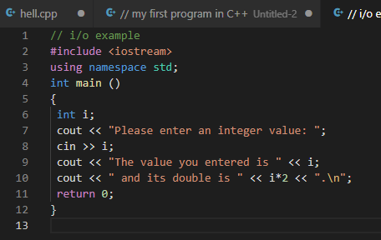
Basic Input/Output
Let’s consider the following example

